Slide 1
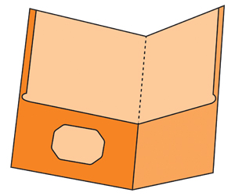
Mrs. Lefeld's Class
The Third Grade Wave
August and September 2023
I‘m so excited to be your child’s teacher.
We are going to have a GREAT year!
Communicator Folder
and Assignment Book
Each student will have a green communication folder and an assignment book that will be taken to each class, and home every night.
Their folders have a clear, outside pocket to place notes for me or the office. The inside pockets are labeled – Return to School and Keep at Home. Please check your child’s folder nightly for homework, papers returned, handouts from school, or notes from me. Doing so will help your child stay organized and ready for each day!
Class Dojo
Please be sure to download the Class Dojo app. This is a quick and easy way for us to communicate. It is also the best way to contact me. Please see the Class Dojo flyer that came home, for directions.
Canvas
Greenville City Schools will utilize the learning management system, Canvas, again this year.
Contact
Email: mlefeld@gcswave.com
School Phone: (937) 548-318
You may also contact me through the Class Dojo app.

Slide 2
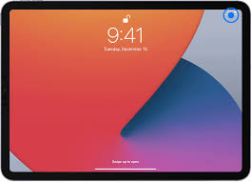
Reading
We will continue using our ELA program, called Wonders, beginning with a focus on characters’ traits, feelings, and motivations, and how these elements affect the sequence of events in a story.
We will also be completing DRAs (Developmental Reading Assessments). DRAs allow teachers to determine each student's instructional level for reading and provides a method for evaluating their individual reading growth over time.
Word Study
Students will be reinforcing phonics skills as well as building skills with word structure. There will not be a spelling test for the first few weeks of school. Each student will be given a spelling inventory sometime during those first few weeks.
When we are ready to begin spelling, a list will be sent home every Monday, and students will be tested over 10 of those words on Fridays.
Writing
The month of September will be spent reviewing paragraph writing. Students will work toward the goal of writing a well-organized paragraph that includes a topic sentence, at least three details that support the topic sentence, and a concluding sentence. As students' progress with these writing skills, we will move into multi-paragraph writing.
Ipad Repair costs:
Replaced cases- $40.00
Cracked Screens- $129.00
Chargers-$19.00
Cables-$19.00
iPads
Students have different learning styles, and iPads can serve as a multipurpose learning tool. Your child will be provided with a school-issued iPad they will use in class daily. Students will utilize various educational apps to build skills in content areas such as reading and math, while also growing in their technological skills. This year, ipads will need to stay at school. Your child would need a charger, if they lost theirs at any point in the last school years.

